Slide 1
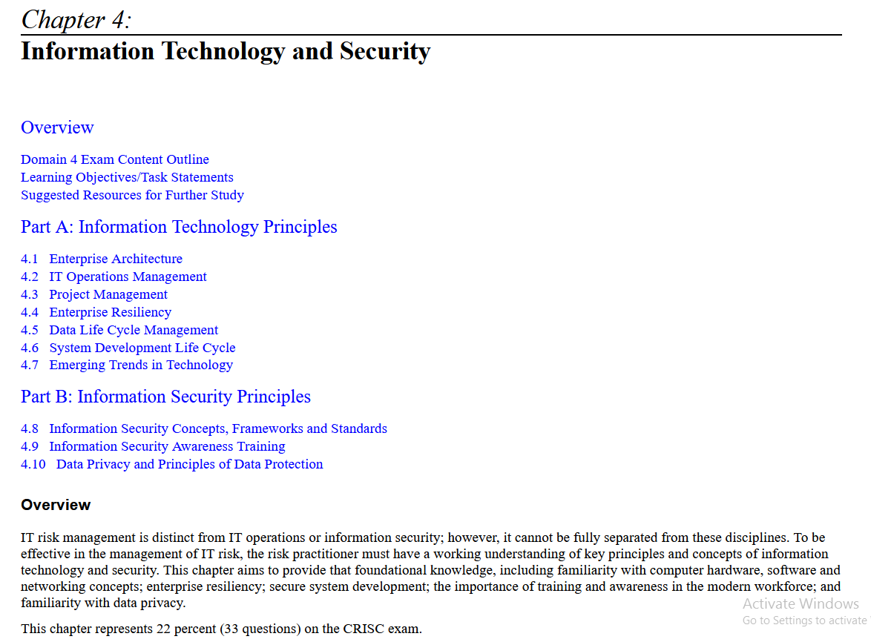

Slide 2
Overview
  IT risk management is distinct from IT operations or information security; however, it cannot be fully separated from these disciplines.
  To be effective in the management of IT risk, the risk practitioner must have a working understanding of key principles and concepts of information technology and security.
  This chapter aims to provide that foundational knowledge, including familiarity with computer hardware, software and networking concepts; enterprise resiliency; secure system development; the importance of training and awareness in the modern workforce; and familiarity with data privacy.
  This chapter represents 22 percent (33 questions) on the CRISC exam.

Slide 3
Part A: Information Technology Principles
4.1 Enterprise Architecture
  enterprise architecture is an essential aspect of business strategy that integrates all aspects of the organization's structure, including its people, processes, and technology.
  By providing a holistic view of the organization, enterprise architecture enables businesses to make informed decisions and optimize their technology investments.
  Enterprise architecture (EA) delivers a view of the current state of IT, establishes a vision for a future state and generates a strategy to move from current to future conditions that minimizes business disruption.
  The enterprise view of IT demonstrates links between IT and organizational objectives and produces a view of current risk and controls to answer or enable answering four basic questions:
      Are we doing the right things?
      Are we doing them the right way?
      Are we getting them done well?
      Are we seeing expected benefits?
  These "Four AREs," shown in Figure 4.1, comprise a cycle of examination, evaluation and adjustment.
  The questions and their answers serve as important continuous feedback to implementation of enterprise IT strategy under an approved architecture and ensure that IT projects deliver their intended value.

Slide 4
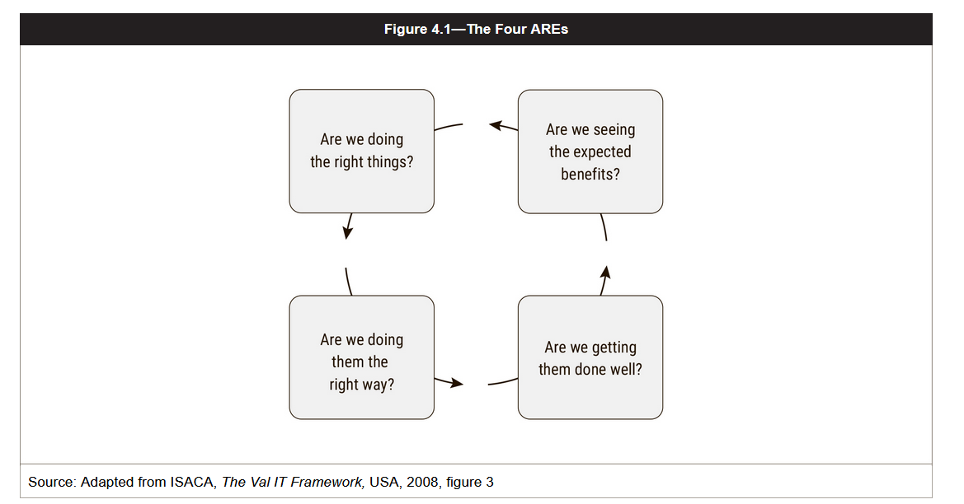

Slide 5
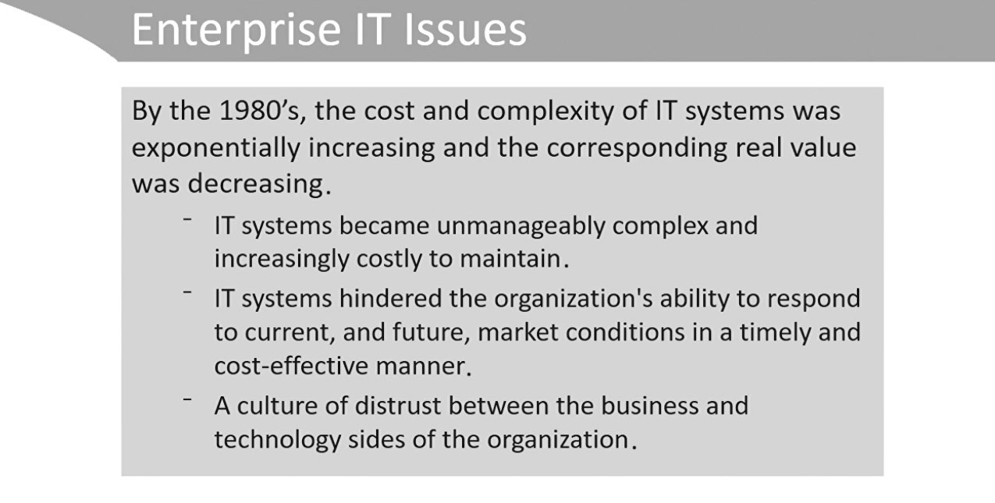
2.5 ENTERPRISE ARCHITECTURE

Slide 6
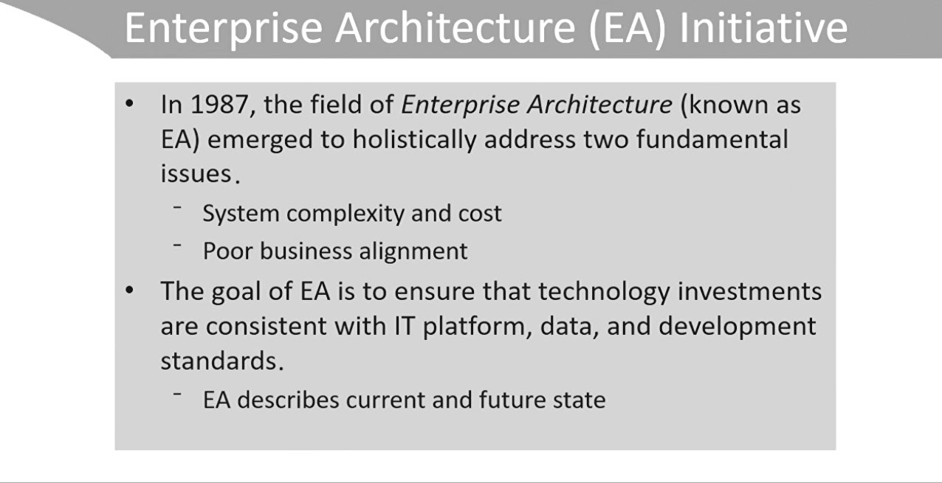
enterprise architecture (EA) is a well-defined practice for conducting enterprise analysis, design, planning, and implementation for the successful development and execution of strategy.
Enterprise Architecture reduces redundancy, complexity and information silos and business risks associated with IT investments.

Slide 7
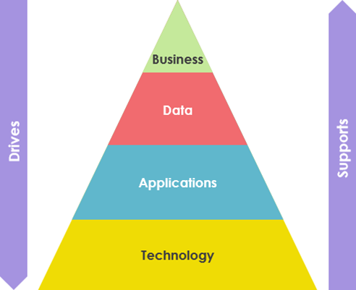
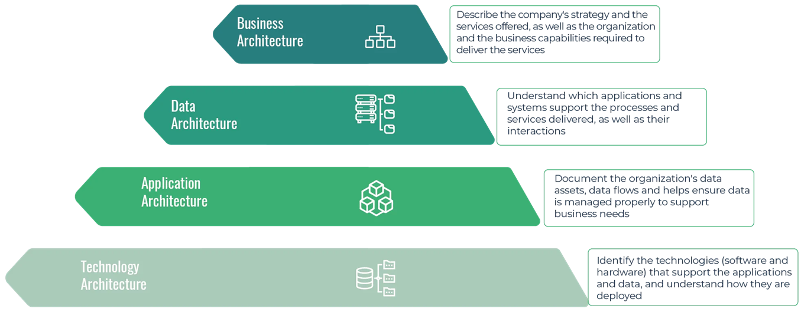
Key Components of Enterprise Architecture
EA provides methods to describe an entire organization's vision to analyze and design it, then plan and implement its evolution. 4 primary architecture layers ensure this completeness:
  Business architecture: This layer describes the company's strategy, the services offered, the organization, and the business capabilities required to deliver the services.
  Application architecture: This layer defines the enterprise's application portfolio, integration, and how these IT assets support the processes and services delivered.
  Information Architecture: This layer defines the enterprise's information requirements and data model and helps ensure data is managed to support business needs.
  Technology architecture: This layer identifies the technologies (software and hardware) that support the applications and data and understand how they are deployed.

Slide 8
Enterprise architecture benefits
  Provide a shared vision of the organization.
  Reduce IT complexity and facilitate the evolution of Information Systems.
  Reduce IT costs by removing redundancies and breaking organizational silos.
  Improve collaboration between business and IT teams.
  Align IT investments, business resources, and organization to the company's strategy.
  Facilitate compliance with regulations.
  Build organizational resilience.
  Ensure system interoperability.
  Standardize practices and processes.

Slide 9
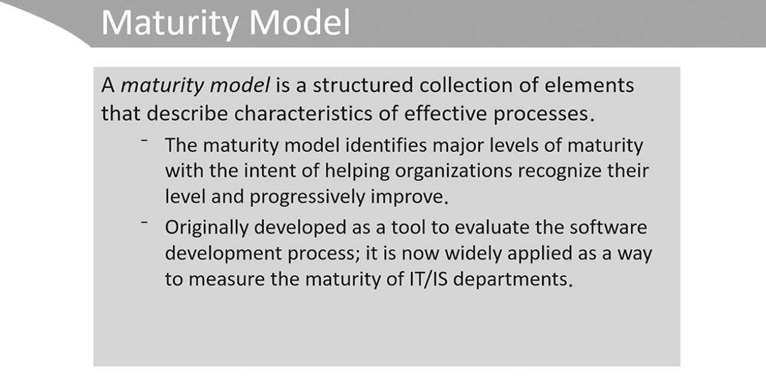

Slide 10
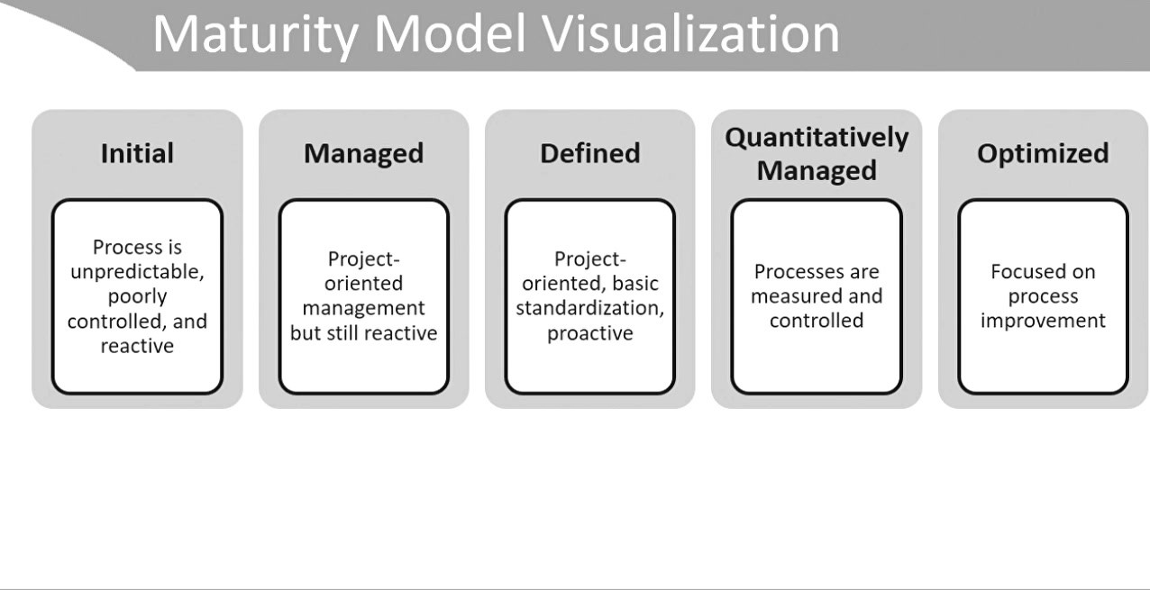

Slide 12
4.2 IT Operations Management
The risk practitioner is not expected or required to be a technical expert in the design, implementation or support of individual IT systems or applications. However, strong knowledge of general IT concepts is invaluable for anyone whose roles and responsibilities require close and ongoing interaction with IT staff.
The identification, assessment and monitoring of IT risk, along with recommendation of appropriate responses to the risk that is identified, require that type of close and ongoing interaction.
Accordingly, the risk practitioner should have a working knowledge of networking, applications and other aspects of IT that appear within the organizational IT infrastructure.

Slide 13
4.2.1 Hardware
IT systems and business processes rely on hardware the equipment and devices that process, store and transmit data.
Hardware includes many devices, such as:
  Desktop, laptop, or mobile computers, which include:
    Central processing units (CPUs)
    Motherboards
    Random access memory (RAM)
    Read-only memory (ROM)
  Networking components (switches, routers, etc.)
  Security components (firewalls, intrusion detection systems, etc.)
  Peripherals (keyboards, monitors, etc.)
  Industrial equipment enabled for networking (smart appliances/Internet of Things devices)

Slide 14
Areas of concern associated with hardware include:
  Poor maintenance
  Misconfiguration
  Use of default credentials
  Lack of secure configurations
  Unnecessary services, ports and protocols running on the system
  Missing or inaccurate documentation
  Missing or inaccurate documentation
  Physical loss or theft
  Data loss due to insecure disposal
  Unauthorized capture of traffic (sniffing)Physical access
  Component or system failure
  Use without authorization
  Inaccurate asset inventory

Slide 15
  Risk practitioners should keep in mind that mobile computers refers not only to tablets but also smartphones, which have evolved to the point of being full-featured systems for information gathering, storage, processing and transmission. In environments where
  users are permitted to have their personal mobile phones with them for use throughout the day, these devices may serve as unsuspecting channels by which data can be exfiltrated if they are compromised.
  mobile phones are among the most easily damaged, stolen and lost items in individual possession.
  Business processes that expect or require staff to use their personal mobile phones for communication may be affected by impacts to these devices, even though they are outside the scope of organizational ownership.

Slide 16
4.2.2 Software
The general concept of software is very broad and includes operating systems (OSs), utilities, drivers, firmware, middleware, application program interfaces (APIs), applications, database management systems (DBMS) and networking tools that manage data, interface between systems, provide user interfaces to hardware and process transactions on behalf of the user.
Areas of concern associated with software include:
  Lack of patching
  Inadequate or ungoverned access control
  Disclosure of sensitive information
  Improper modification of information
  Loss of source code
  Lack of version control
  Processing of input and output without validation
  Unnecessary services and protocols running on the system
  Unnecessary ports open on the system
  Lack of a security software development life cycle

Slide 17
Operating Systems
  The OS is the core software that allows the user to interface with hardware and manages all system operations.
  The OS manages access to system resources and controls the behavior of system components.
  Areas of concern associated with the OS include:
    Unpatched vulnerabilities
    Poorly written code (buffer overflows, etc.)
    Complexity
    Misconfiguration
    Weak access controls
    Lack of interoperability
    Uncontrolled changes
    Unnecessary services and protocols running on the system
    Unnecessary ports open on the system
  Currently, most desktop computers use versions of Windows, Mac OS or Linux, while mobile devices commonly run Apple iOS or Google Android.

Slide 18
The risk practitioner should keep in mind that no commercially available OS is absolutely secure; therefore, regardless of the underlying platform, it is necessary to implement strict controls over changes, patches and configurations.
When ever possible , systems should be hardened to disable unnecessary services and default accounts and passwords should always be changed.
Deployment of security patches is important and should be subject to a patch management process that identifies, tests and schedules implementation.
Testing should not be skipped because it is possible for a patch to create negative effects on systems.
Even with rigorous testing, after a patch has been implemented, it should be monitored to ensure that all related systems, utilities and applications are still working correctly.

Slide 19
Applications
  Application risk is often due to flaws or bugs in the coding of the application.
  This is especially true for web and mobile applications, including those developed by an organization for internal use as well as those written by third-party developers.
  Countermeasures to web application vulnerabilities are related to proper design, coding and testing.
  The Open Web Application Security Project (www.owasp.org) and similar resources list common web application vulnerabilities and provide direction on how to mitigate and test for such vulnerabilities.
  Areas of concern associated with applications include:
    Poor or no data validation
    Exposure of sensitive data (i.e., lack of encryption/obfuscation)
    Improper modification of data
    Logic flaws (i.e., logic errors)
    Software bugs (i.e., coding errors)
    Lack of logs
    Lack of version control
    Loss of source code
    Weak or lack of access control
    Lack of operability with other software
    Back doors
    Poor coding practices
    Lack of governance over how data are stored

Slide 20
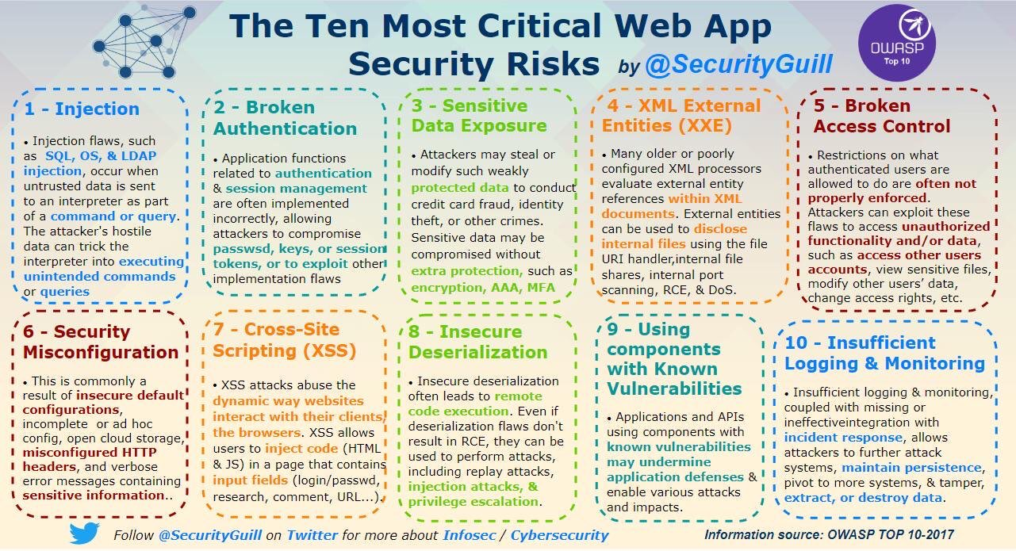

Slide 21
Databases
  Where large amounts of information need to be stored and retrieved on a regular basis, organizations commonly use databases.
  Database security is important because databases tend to contain critical and sensitive information that supports business operations.
  Database security is provided through the following:
    Encryption of sensitive data in the database
    Use of database views to restrict information available to a user
    Secure protocols to communicate with the database
    Content-based access controls that restrict access to sensitive records
    Restricting administrator-level access
    Efficient indexing to enhance data retrieval
    Backups of databases (shadowing, mirroring)
    Backups of transaction journals (remote journaling)
    Encryption of backups
    Referential integrity
    Entity integrity
    Validation of input
    Defined data fields (schema)
  Database servers should be placed behind significant protective measures and not directly accessible from outside organizational boundaries.

Slide 22
4.2.3 Environmental Controls
  Environmental controls include power and heating, ventilation and air conditioning (HVAC) systems that support IT operations.
  Unlike humans, computer systems may immediately shut off (as with loss of power) or endure under conditions that can lead to electrical or mechanical errors (as with loss of ventilation or unregulated temperature), These impacts may in turn affect business processes by interrupting processes or causing them to be completed incorrectly.
  Areas of concern associated with environmental controls include:
    Power interruptions
    Loss of power
    Surge
    Spikes
    Sags
    Brownouts
    Faults
    Generators
      Insufficient capacity
      Poor maintenance
      Latency of generator to power on
    Batteries
      Poorly maintained
      Outdated
    HVAC
    Overheating
    Humidity problems
      Corrosion and condensation (high humidity)
      Static (low humidity)
    Clogged filters
    Lack of maintenance
    Water
      Loss of water needed for cooling systems
    Health and safety issues
    Secure operational areas
      Restricted access to server rooms and wiring closets
      Secure access to power supplies, generators, elevator shafts

Slide 23
4.2.4 Networks
  take many forms and can be made up of a variety of specialized devices including cabling, switches, routers, firewalls, gateways and wireless access points.
  They can range in size from two devices to the Internet itself, which is simply a global network of interconnected devices operating on essentially the same principles.
  most modern networks are digital, where the communications are sent via electrical signals or pulses of light.
  Networks are used for many purposes, including:
      Transferring data between individuals
      Transferring data between applications
      Controlling and monitoring of remote equipment (such as industrial or supervisory control and data acquisition [SCADA] networks)
      Backing up data
      Enabling communication between end-user devices (e.g., Bluetooth)

Slide 24
When assessing networks, the risk practitioner should consider:
  Network configuration and management, including the criticality of network operations
  Network equipment protection
  The use of layered defense (defense in depth)
  Suitable levels of redundancy
  Availability of bandwidth sufficient for intended use cases
  Use of encryption for transmission of sensitive data
  Management of encryption keys
  Damage to cabling and network equipment
  Eavesdropping on communications through physical tapping or logical interception (e.g., man in the middle) Choices and documentation of network architecture
  Management of flow of information via network devices like firewalls, routers, switches, etc.

Slide 25
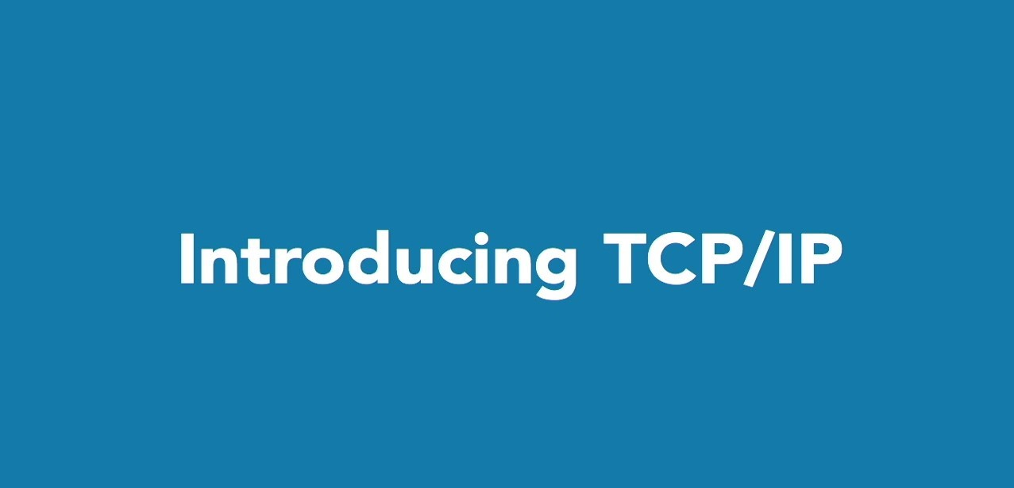

Slide 26
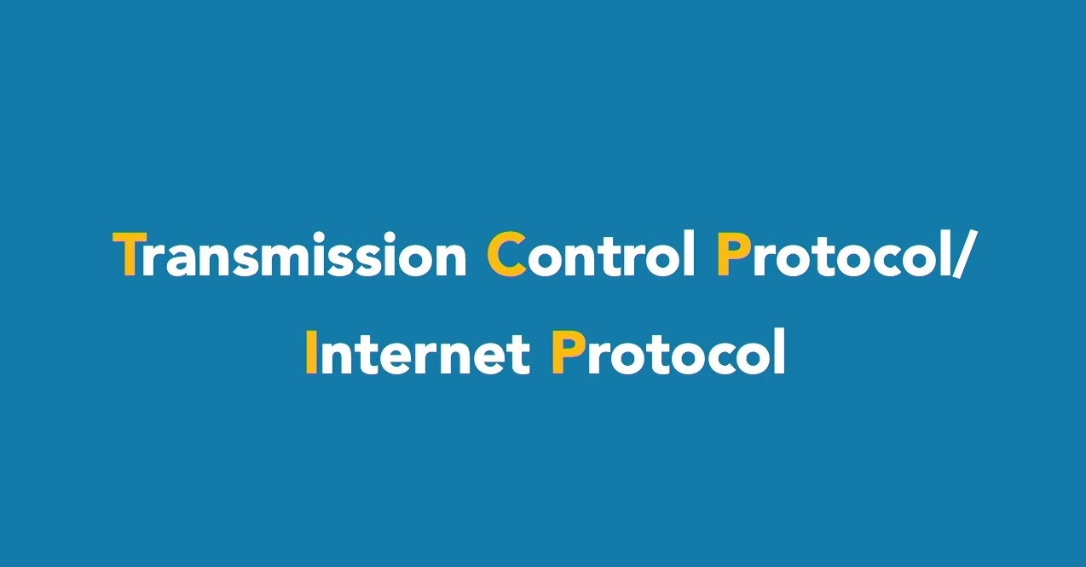

Slide 27
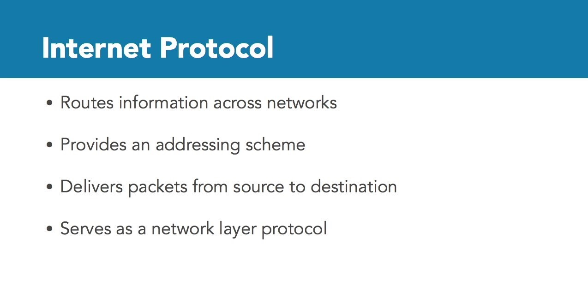

Slide 28
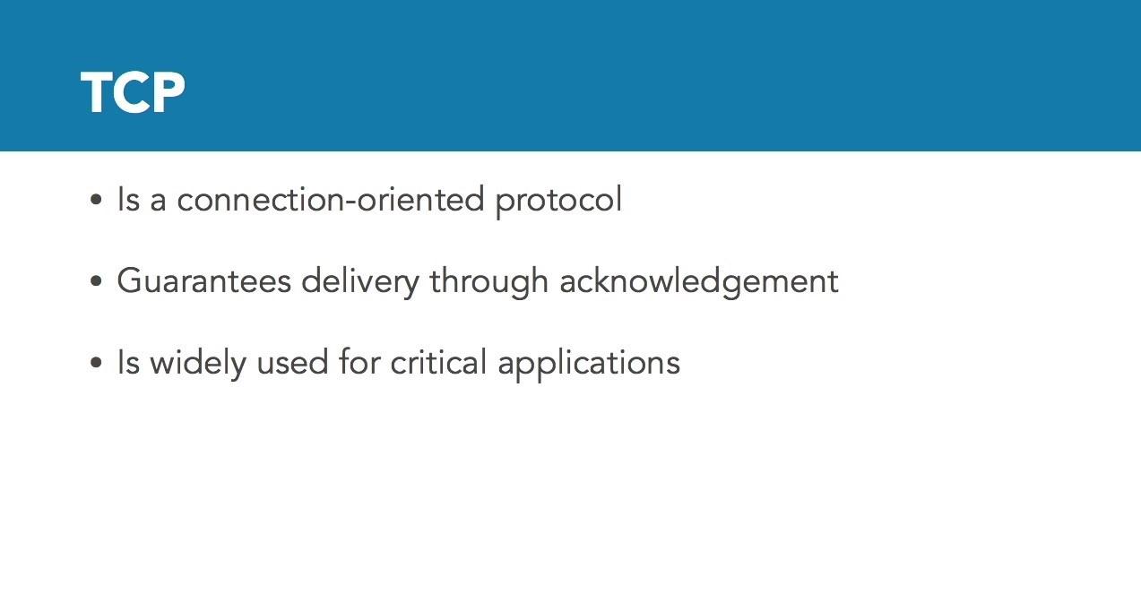

Slide 29
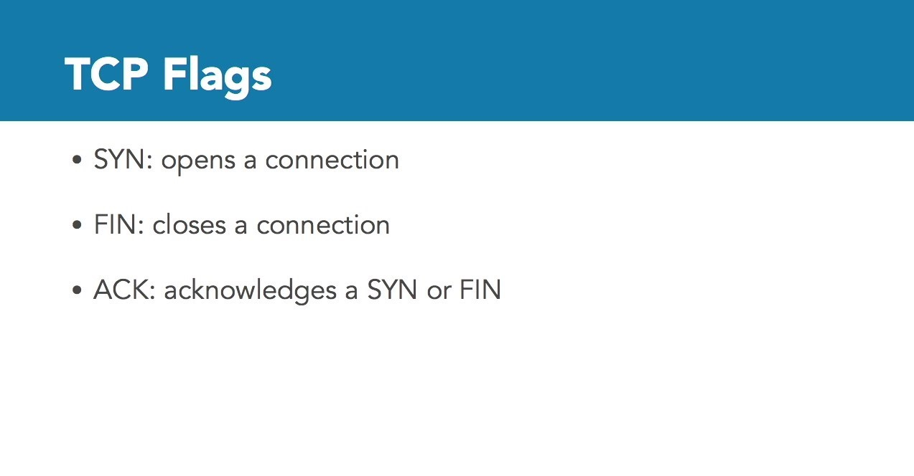

Slide 30
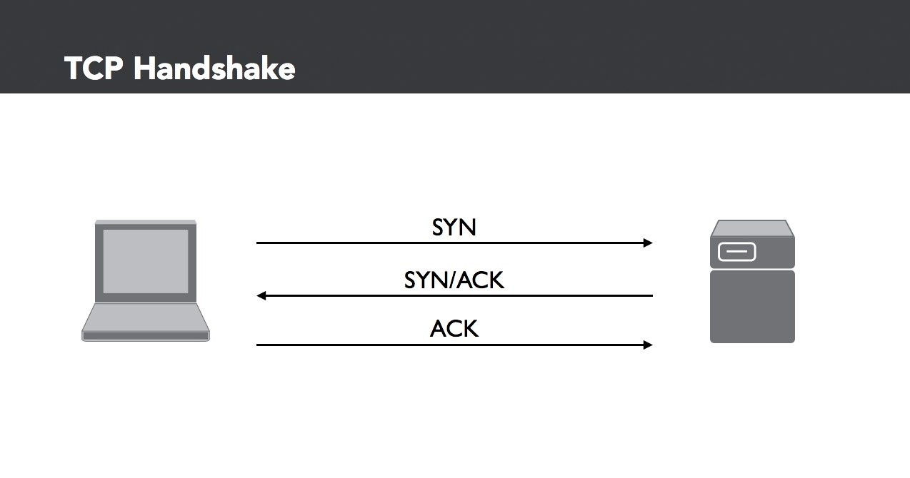

Slide 31
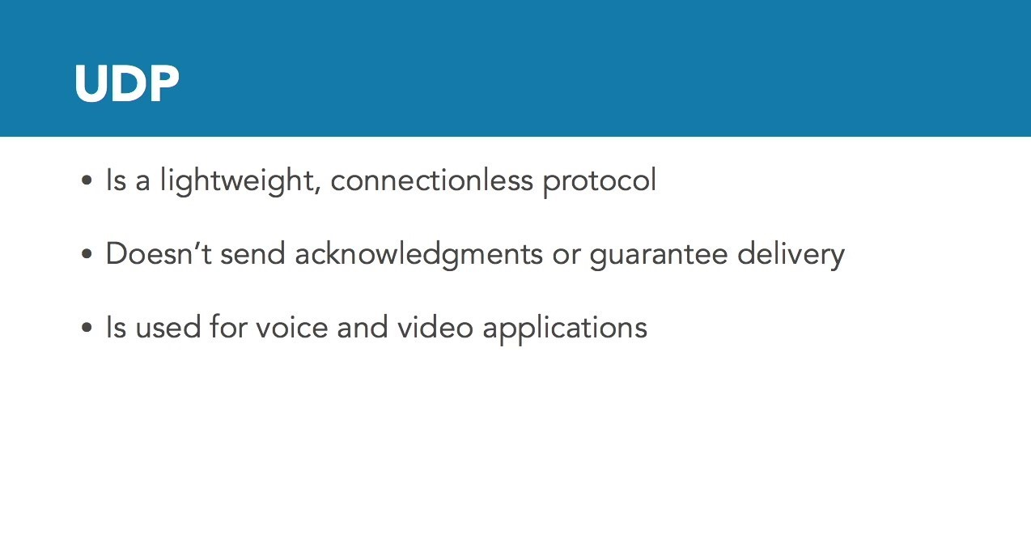

Slide 32
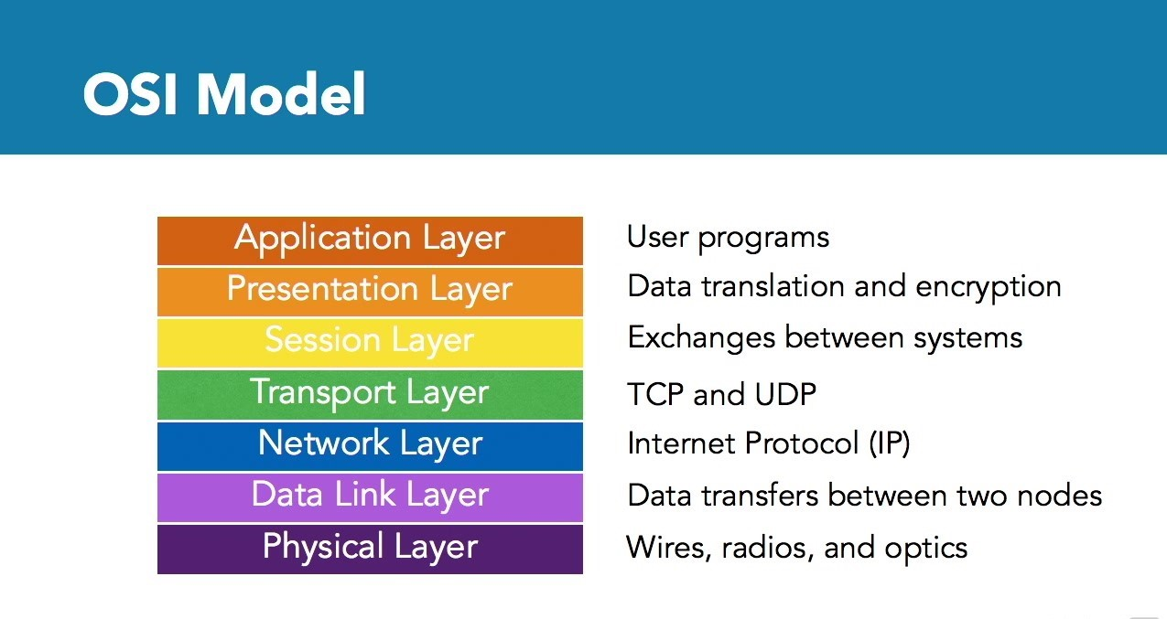

Slide 33
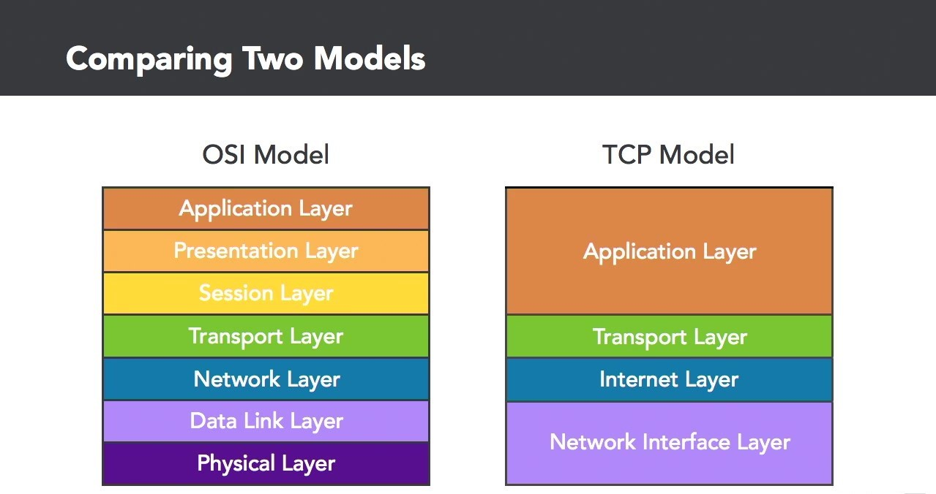

Slide 34


Slide 35
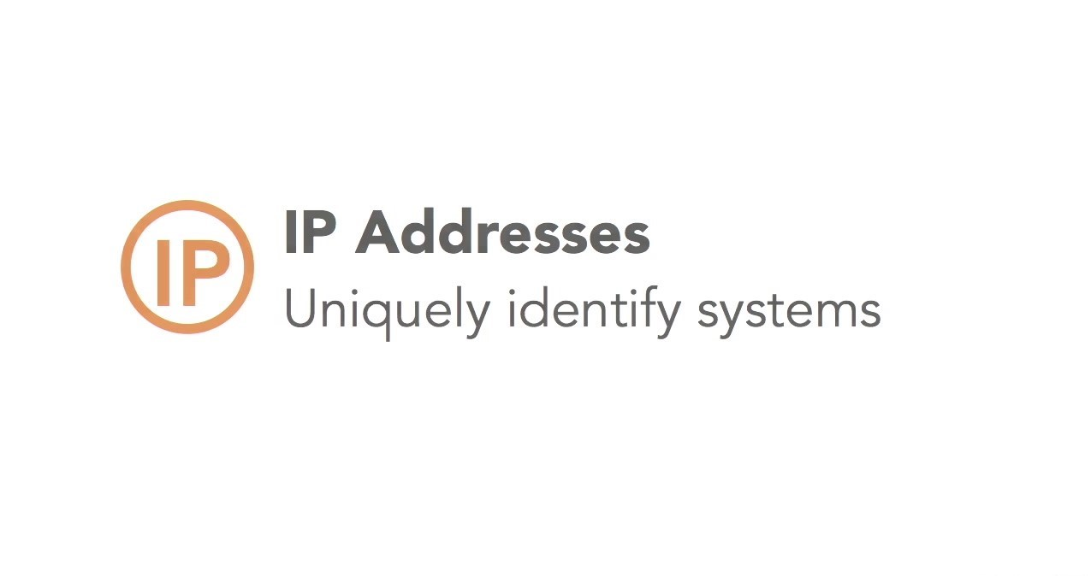

Slide 36


Slide 37
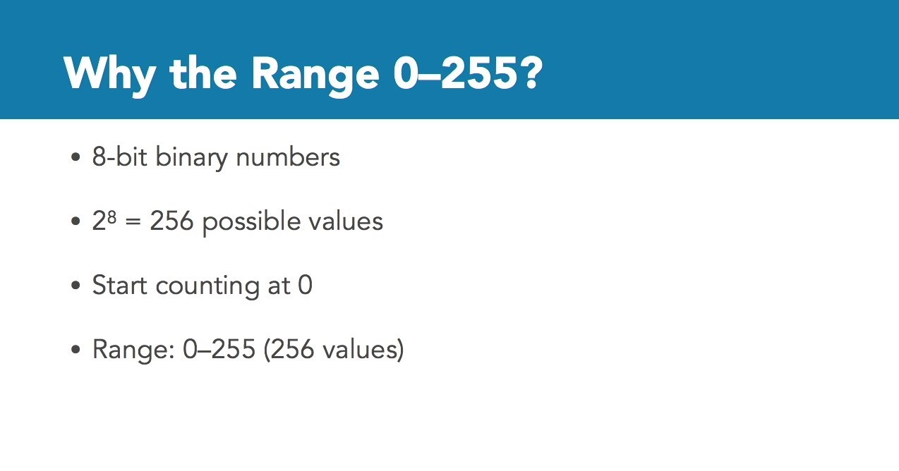

Slide 38
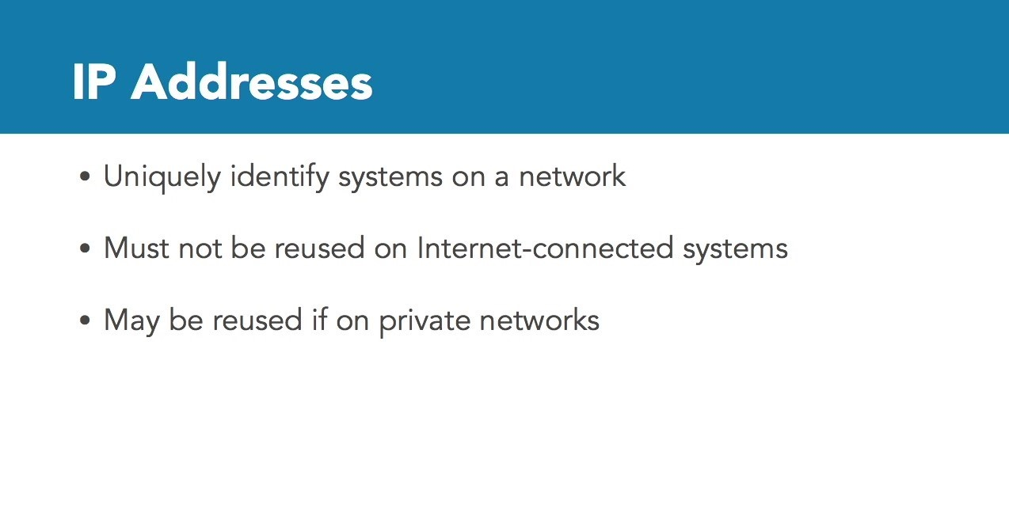

Slide 39
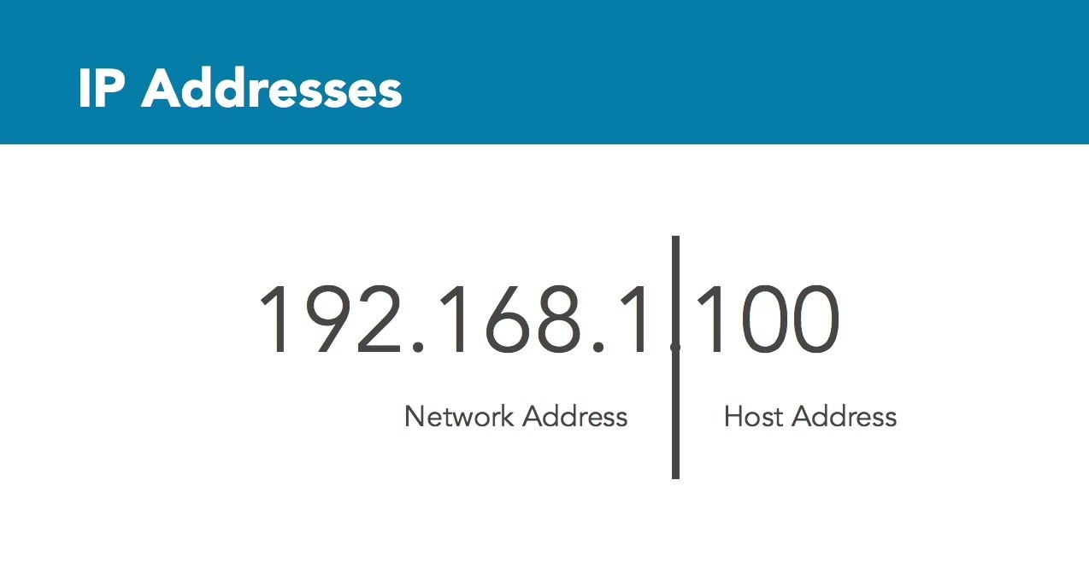

Slide 40
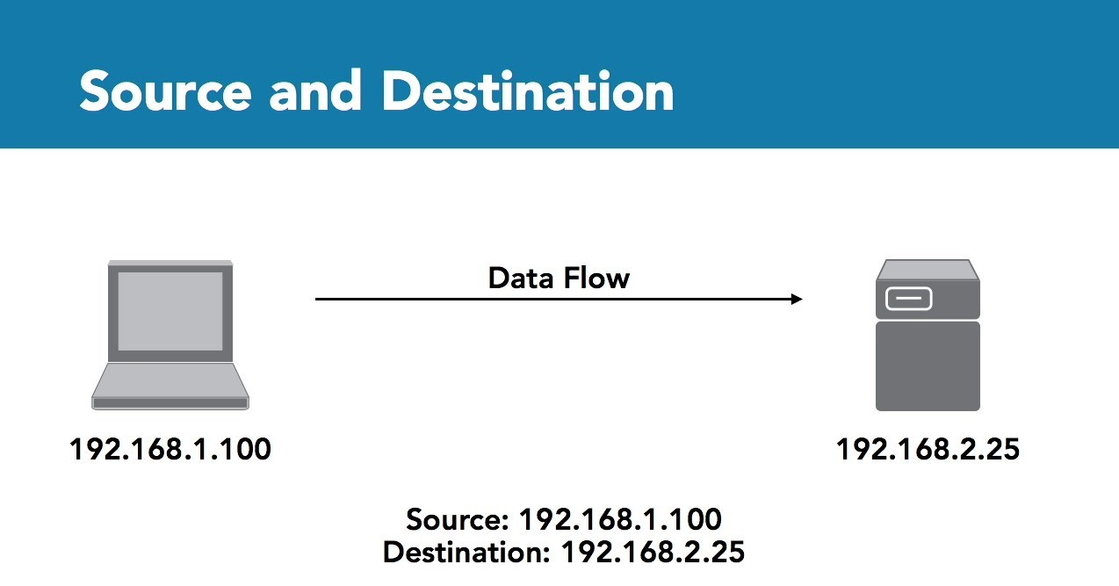

Slide 41
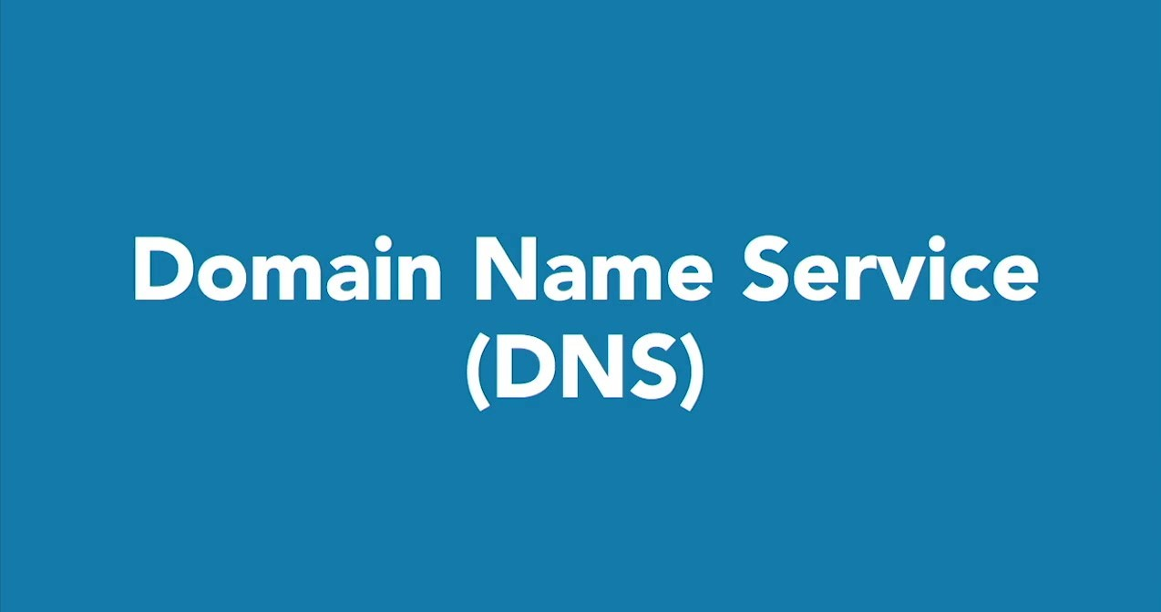

Slide 42
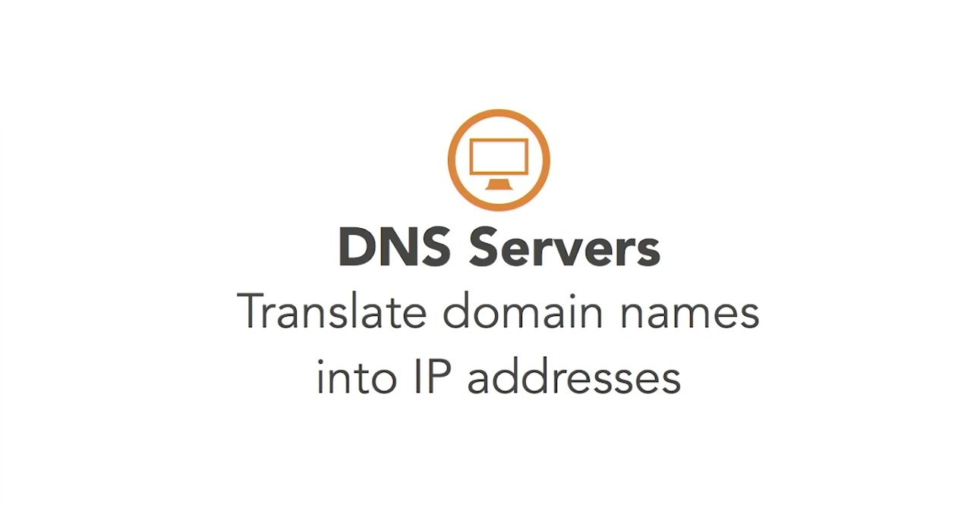

Slide 43
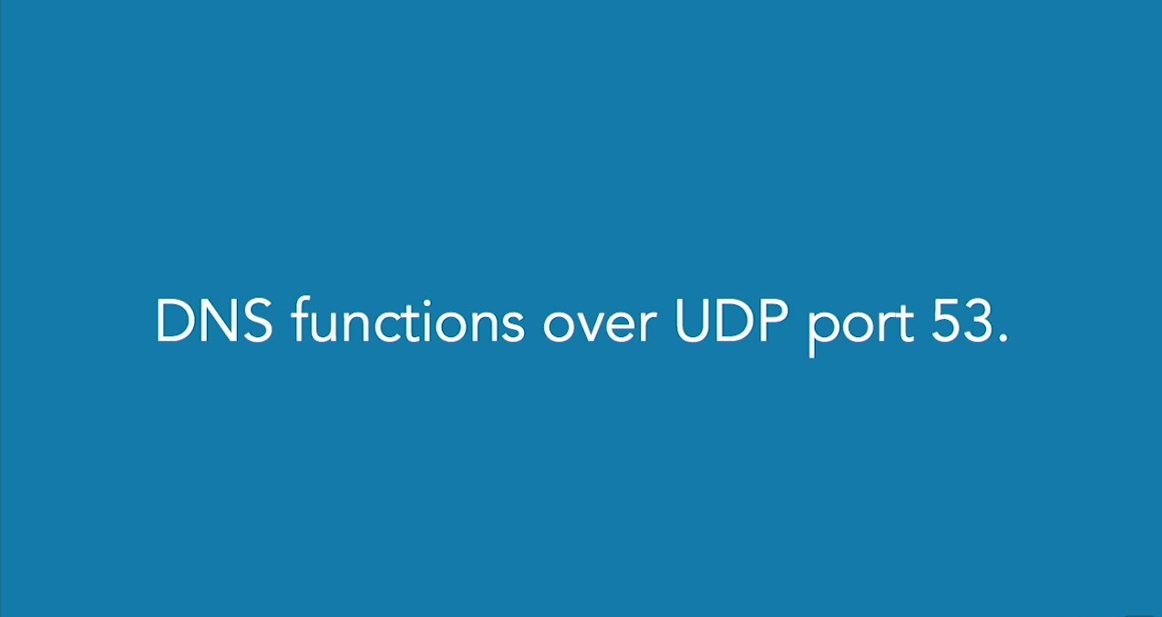

Slide 44
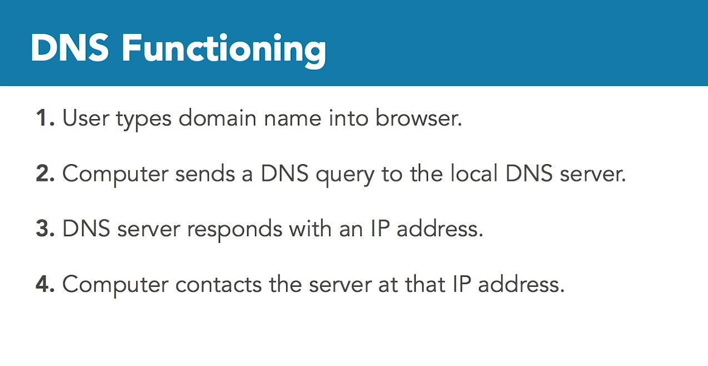

Slide 45
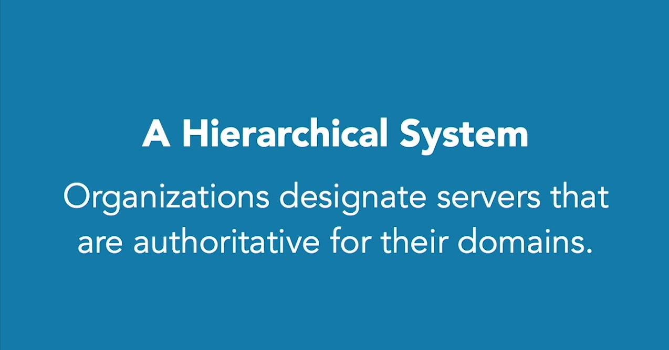

Slide 46


Slide 47


Slide 48
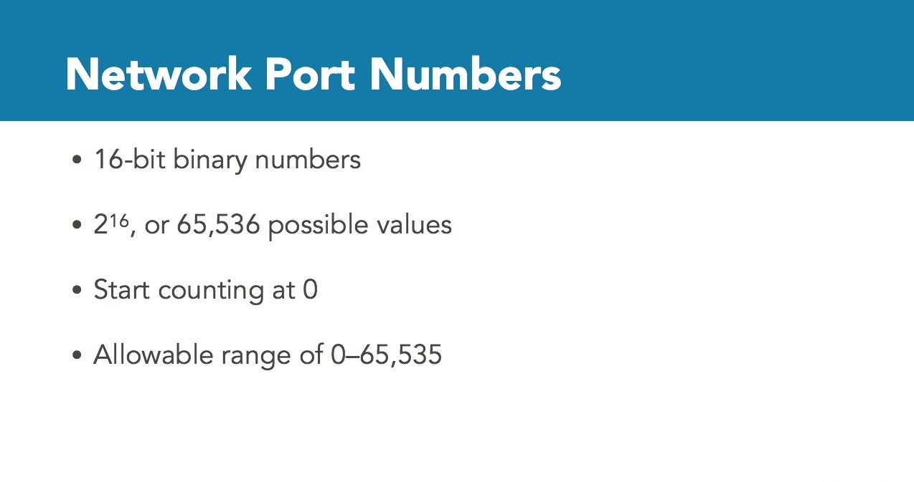

Slide 49
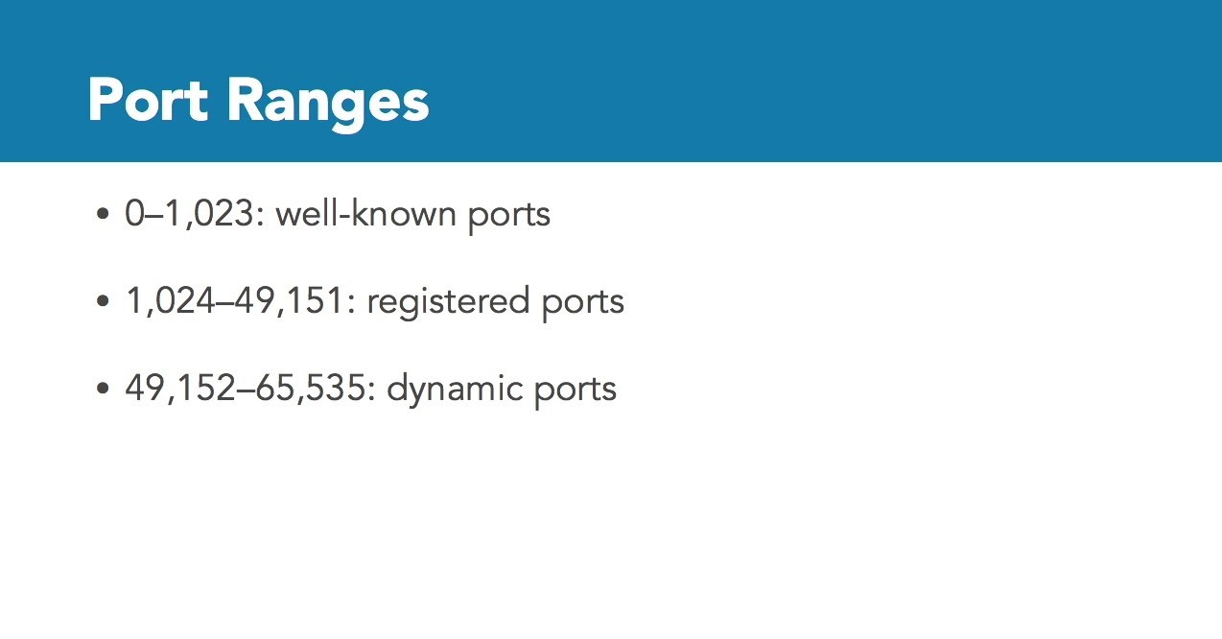

Slide 50
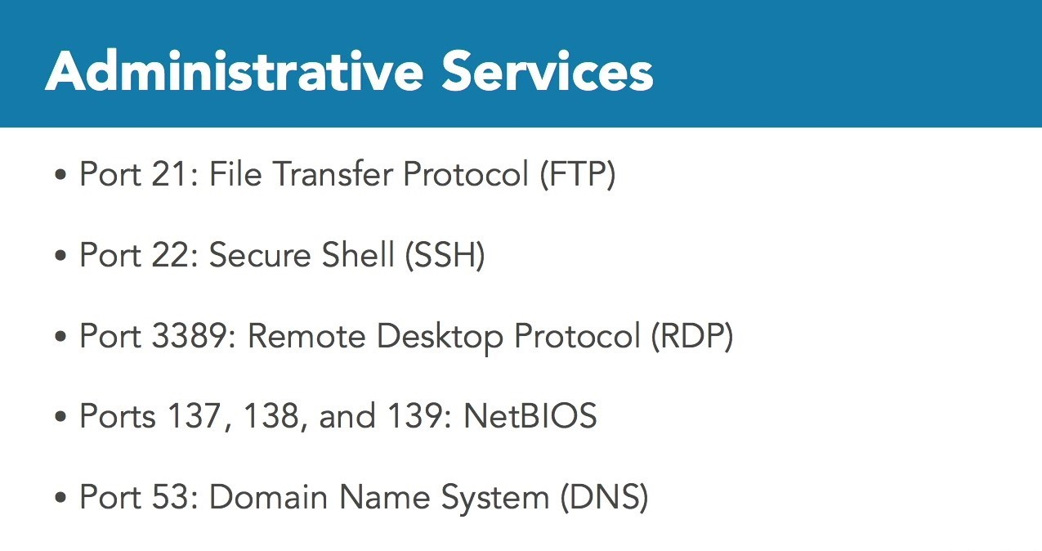

Slide 51
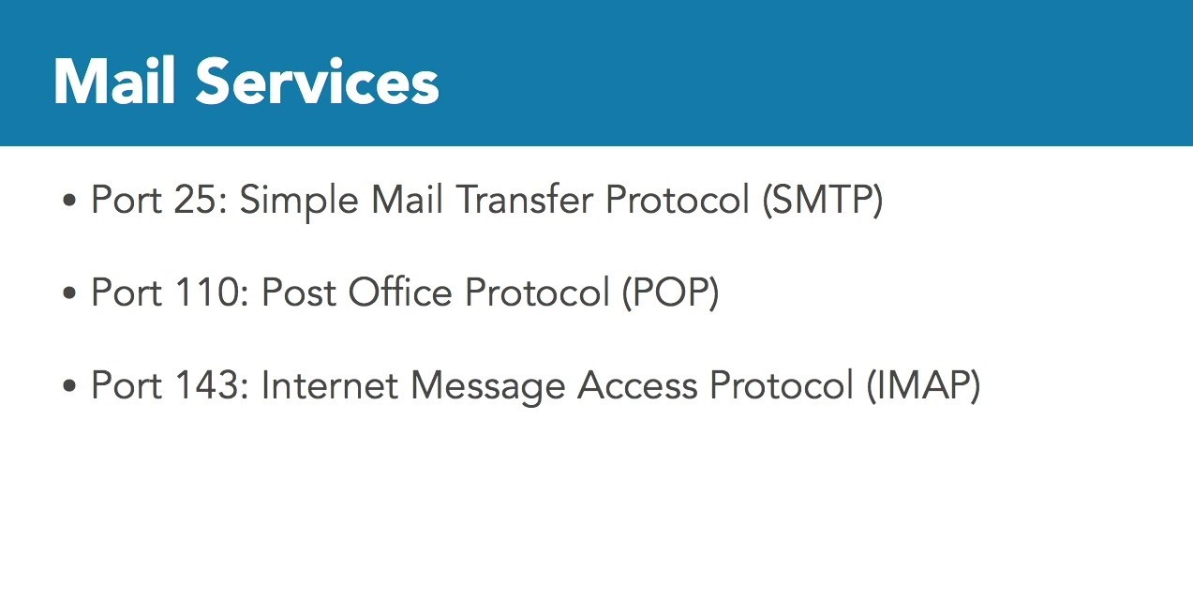

Slide 52
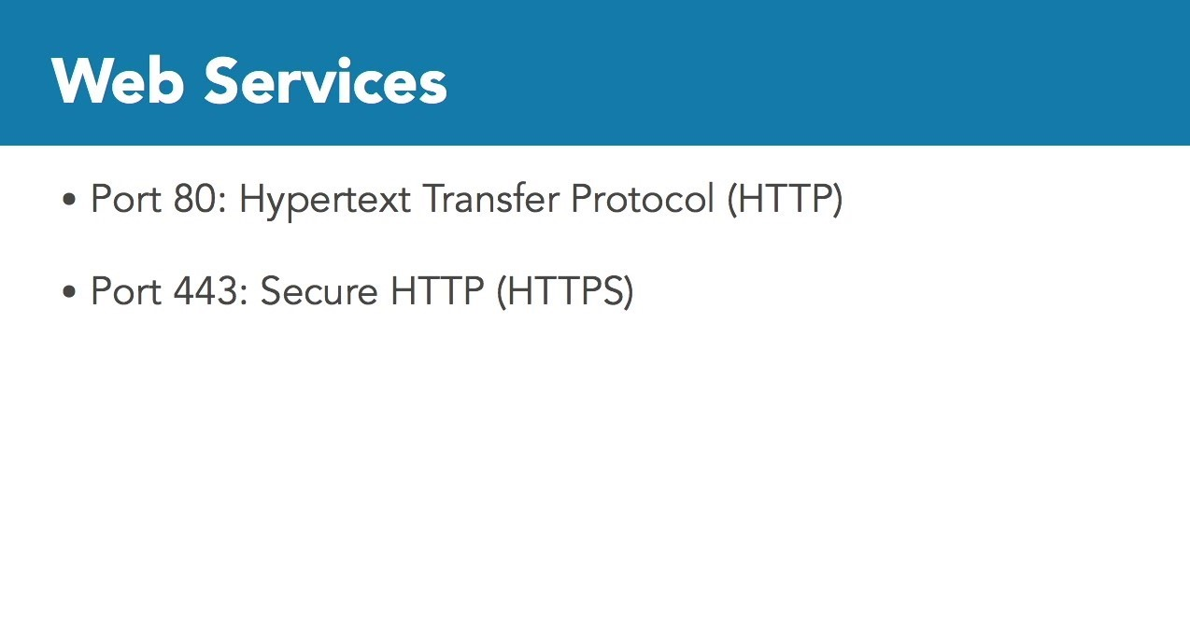

Slide 53
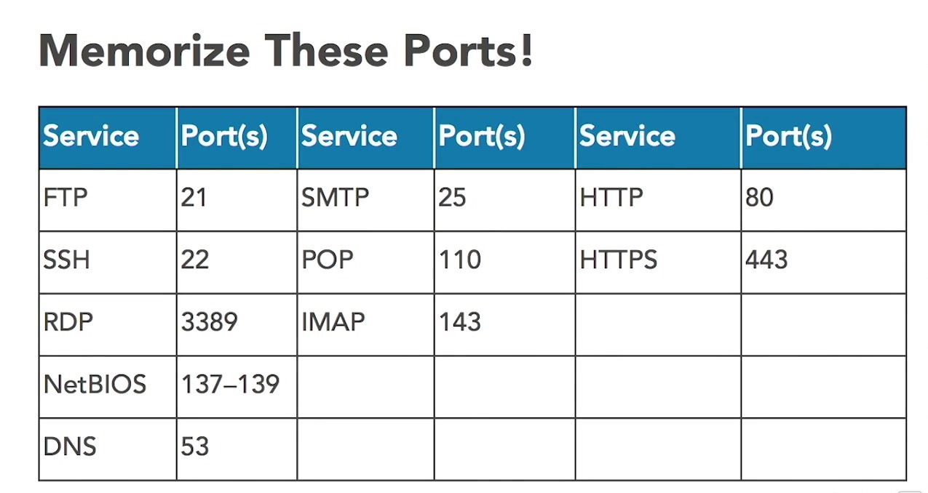

Slide 54


Slide 55
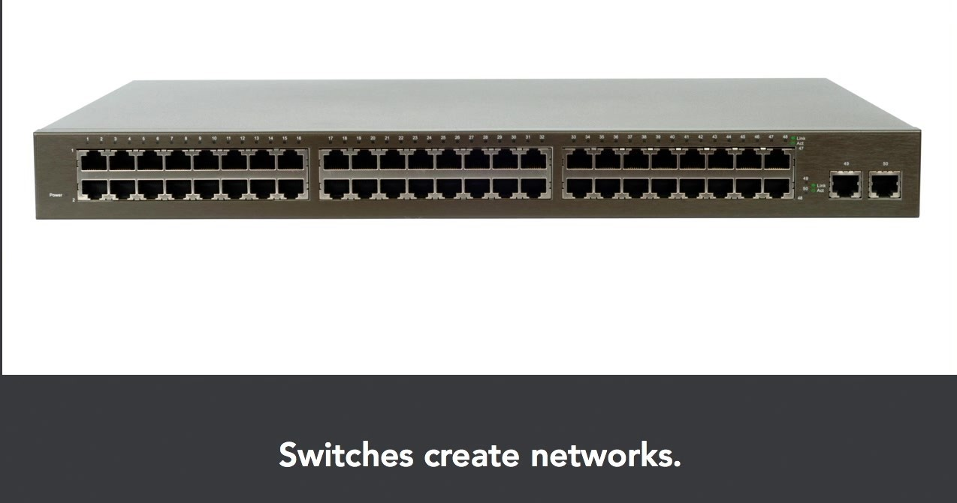

Slide 57
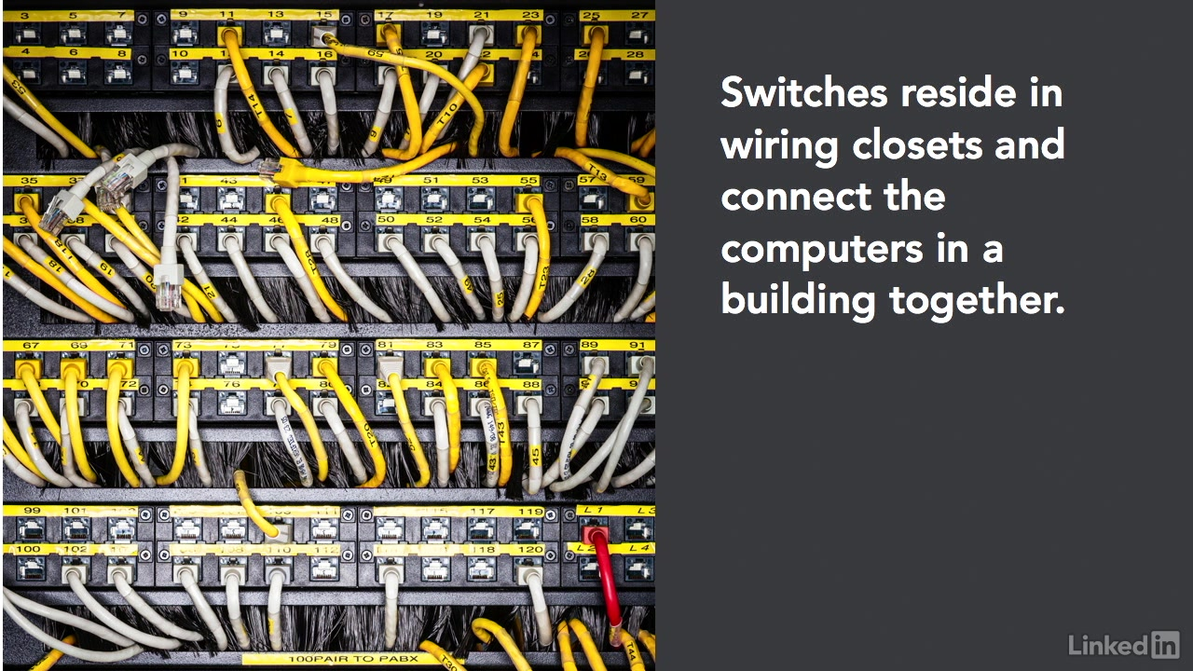

Slide 58
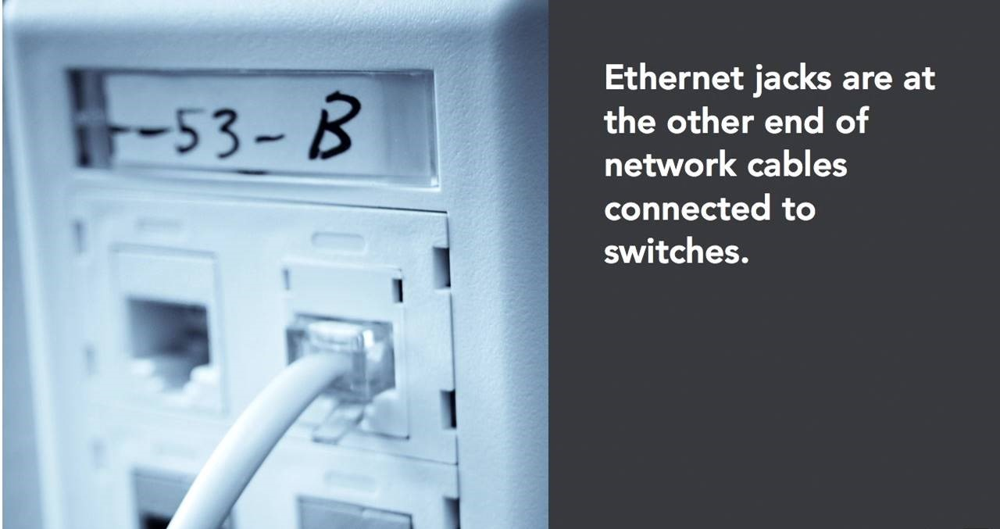

Slide 60
SPAN ports
Since switches provide traffic isolation, a Network Intrusion Detection System (NIDS) connected to a 24-port switch will not see unicast traffic sent to and from other devices on the same switch.
Configuring a Switched Port Analyzer (SPAN) port is one way to solve this problem, by mirroring traffic from multiple switch ports to one “SPAN port.” SPAN is a Cisco term; HP switches use the term “Mirror port.”
One drawback to using a switch SPAN port is port bandwidth overload. A 100-megabit, 24-port switch can mirror twenty-three 100-megabit streams of traffic to a 100-megabit SPAN port. The aggregate traffic could easily exceed 100 megabits, meaning the SPAN port (and connected NIDS) will miss traffic.
NETWORK TAPS
A network tap provides a way to “tap” into network traffic, and see all traffic (including all unicast connections) on a network.
Taps are the preferred way to provide promiscuous network access to a sniffer or Network Intrusion Detection System.
Taps can “fail open,” so that network traffic will pass in the event of a failure.
Taps can also provide access to all traffic, including malformed Ethernet frames. A switch will often “clean” that traffic and not pass it. Finally, Taps can be purchased with memory buffers, which cache traffic bursts.

Slide 61
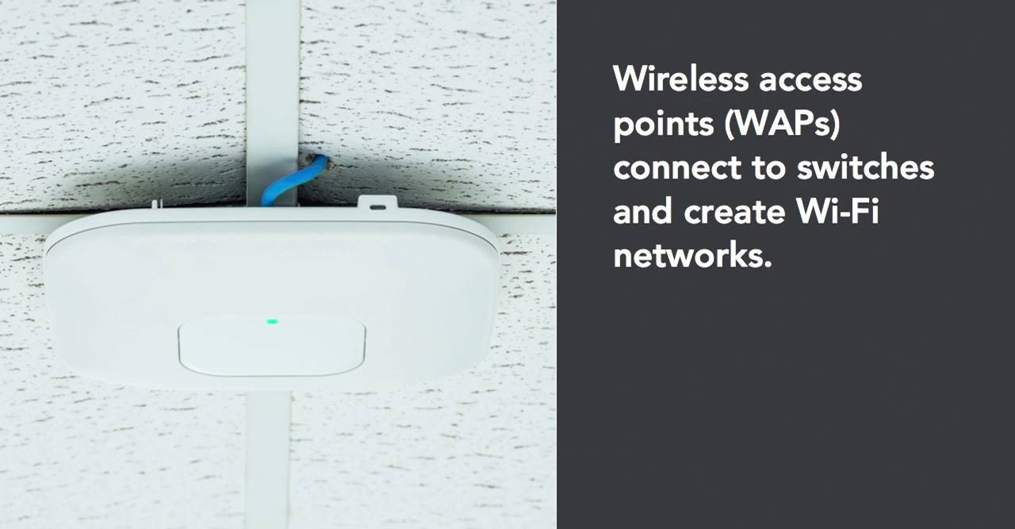

Slide 62
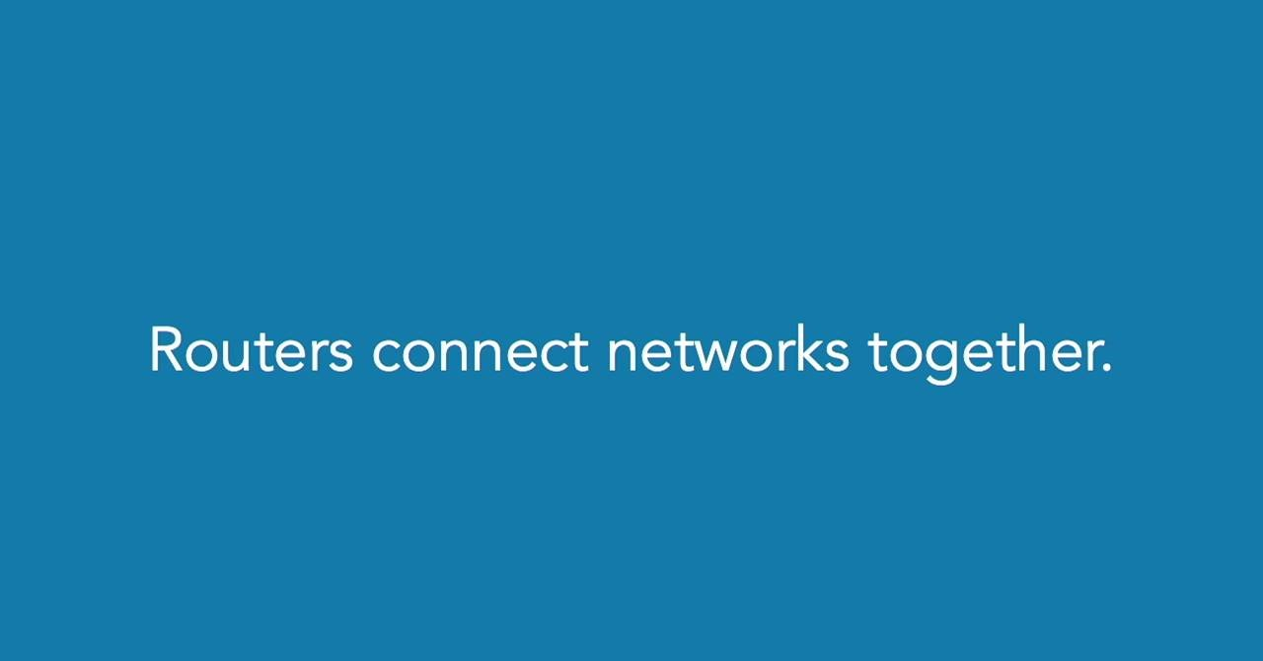

Slide 63
This network has redundant paths between all four sites. Should any single circuit or site go down, at least one alternate path is available.
The fastest circuits are the 45-megabit T3s that connect the data center to each office. Additional 1.5 megabit T1s connect Office A to B, and B to C.
Should the left-most T3 circuit go down, between the Data Center and Office A, there are multiple paths available from the data center to Office A: the fastest is the T3 to Office B, and then the T1 to Office A.

Slide 64


Slide 65
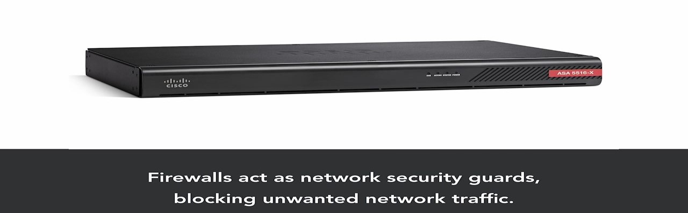
Firewalls filter traffic between networks.
TCP/IP packet filter and stateful firewalls make decisions based on layers 3 and 4 (IP addresses and ports). Proxy firewalls can also make decisions based on layers 5–7.
Firewalls are multi-homed: they have multiple NICs connected to multiple different networks.

Slide 66
Packet Filter
A packet filter is a simple and fast firewall. It has no concept of “state”: each filtering decision must be made on the basis of a single packet. There is no way to refer to past packets to make current decisions.
The lack of state makes packet filter firewalls less secure, especially for session less protocols like UDP and ICMP.
In order to allow ping via a firewall, both ICMP Echo Requests and Echo Replies must be allowed, independently: the firewall cannot match a previous request with a current reply. All Echo Replies are usually allowed, based on the assumption that there must have been a previous matching Echo Request.
UDP-based protocols suffer similar problems. DNS uses UDP port 53 for small queries, so packet filters typically allow all UDP DNS replies on the assumption that there must have been a previous matching request.

Slide 67
Stateful Firewalls
Stateful firewalls have a state table that allows the firewall to compare current packets to previous ones. Stateful firewalls are slower than packet filters, but are far more secure.
The evil.example.com sends an unsolicited ICMP Echo Reply. The stateful firewall, sees no matching state table entry, and denies the traffic.

Slide 68
Proxy Firewalls
Proxies are firewalls that act as intermediary servers.
Proxies terminate connections.
Web traffic from Computer 1 to bank.example.com passing via a stateful firewall and a proxy firewall.
  The stateful firewall passes one TCP three-way handshake between Computer 1 and bank.example.com. A packet filter will do the same.
  The proxy firewall terminates the TCP connection from Computer 1, and initiates a TCP connection with bank.example.com. In this case, there are two handshakes:
  Computer 1 → Proxy, and Proxy → bank.example.com.
Like NAT, a proxy hides the origin of a connection.

Slide 69
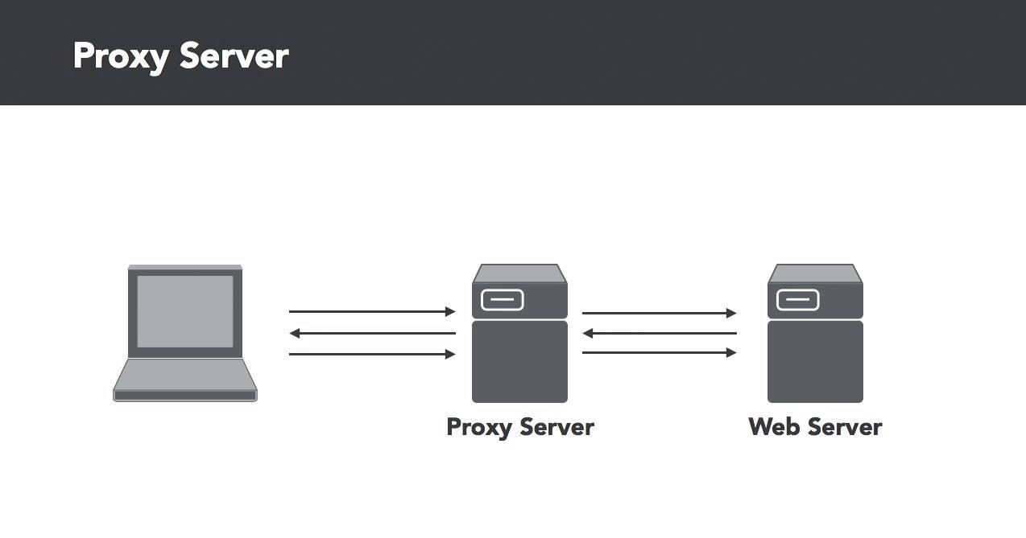

Slide 70
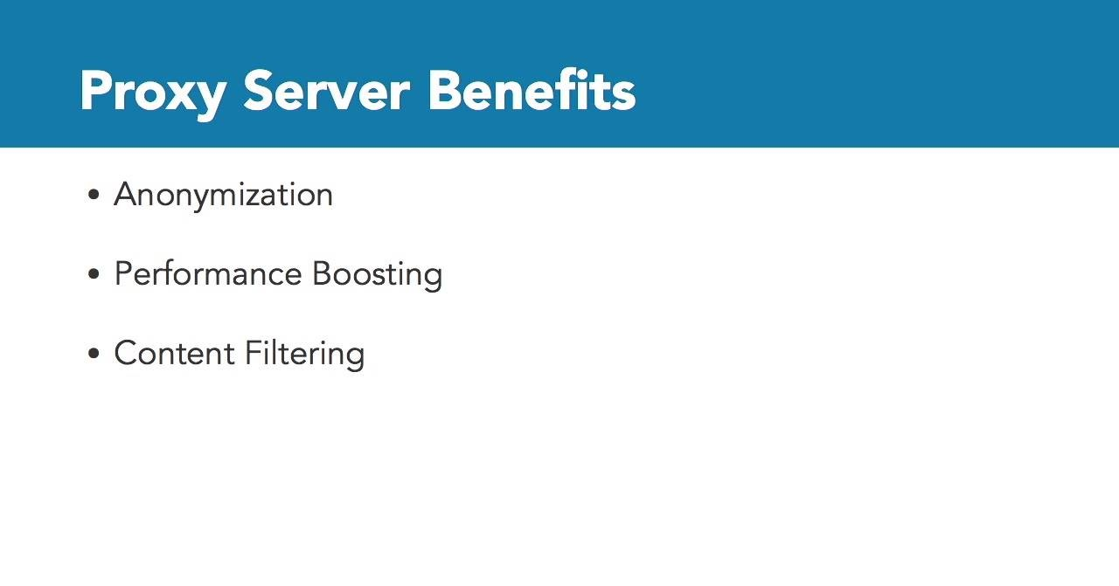

Slide 71
Application-Layer Proxy Firewalls
Application-layer proxy firewalls operate up to Layer 7. Unlike packet filter and stateful firewalls that make decisions based on layers 3 and 4 only, application-layer proxies can make filtering decisions based on application-layer data, such as HTTP traffic, in addition to layers 3 and 4.
Application-layer proxies must understand the protocol that is proxied, so dedicated proxies are often required for each protocol: an FTP proxy for FTP traffic, an HTTP proxy for Web traffic, etc. This allows tighter control of filtering decisions.
Instead of relying on IP addresses and ports alone, an HTTP proxy can also make decisions based on HTTP data, including the content of Web data, for example. This allows sites to block access to explicit Web content.

Slide 72
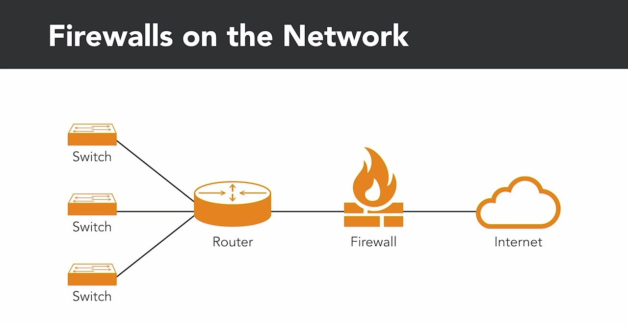

Slide 73
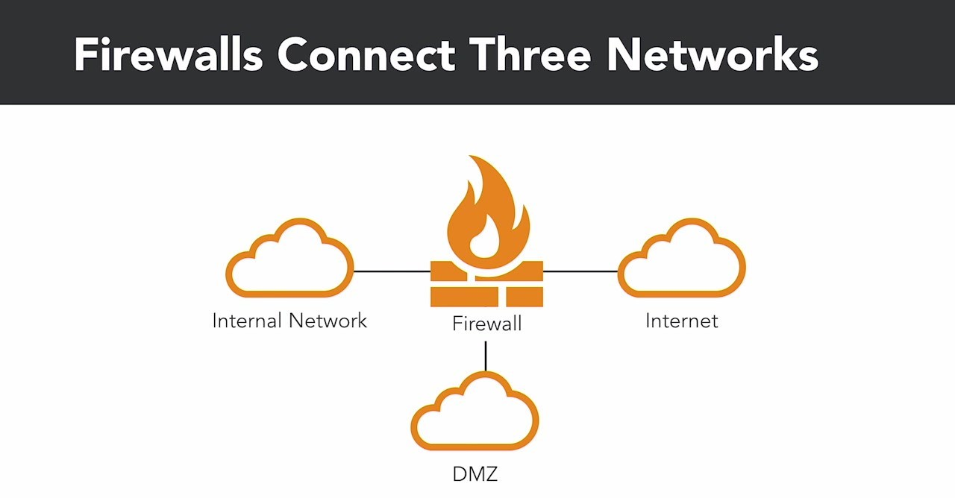

Slide 74
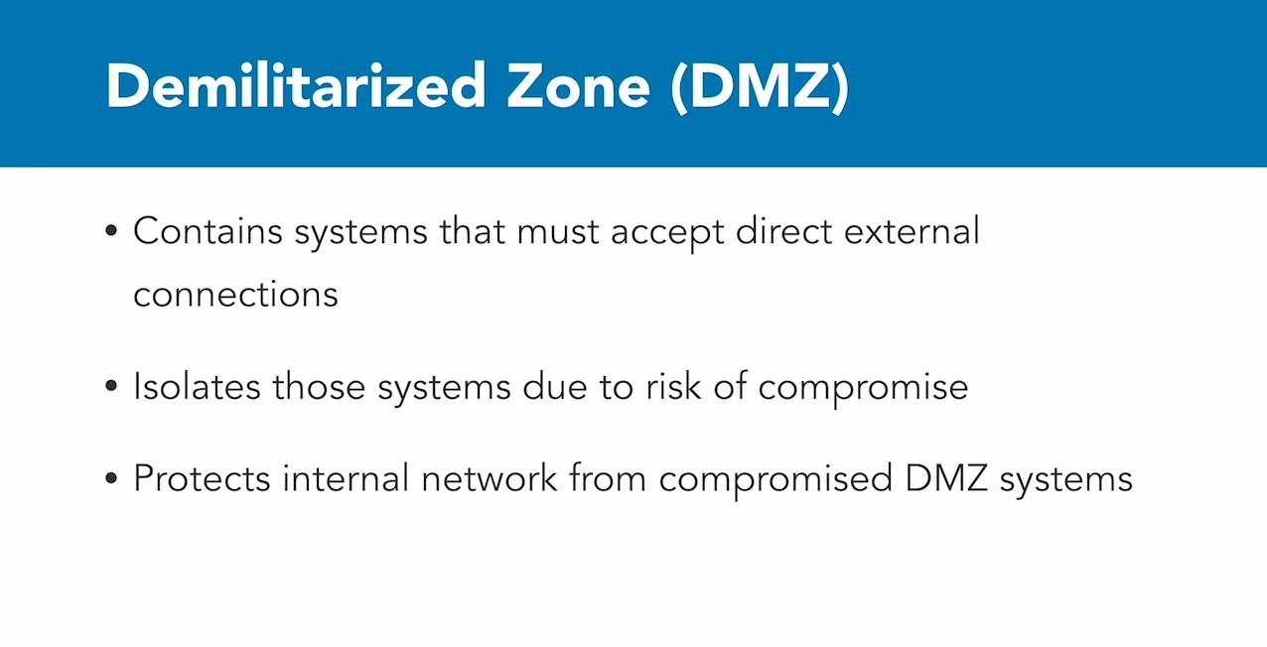

Slide 75


Slide 76
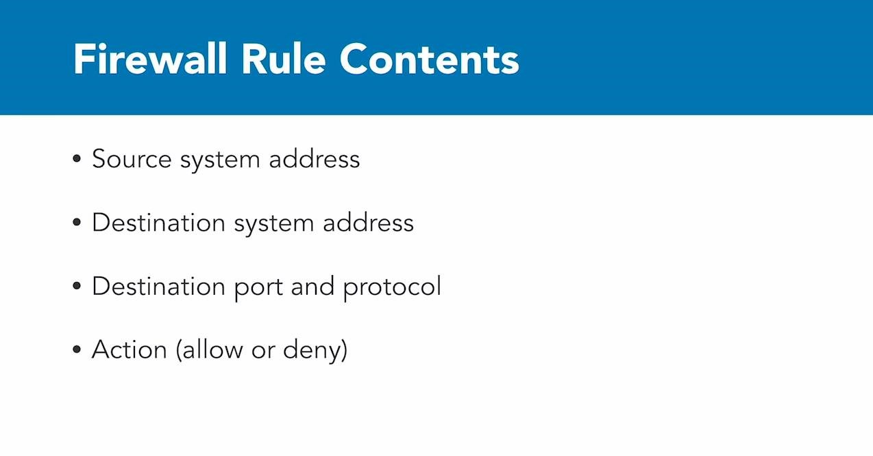

Slide 77
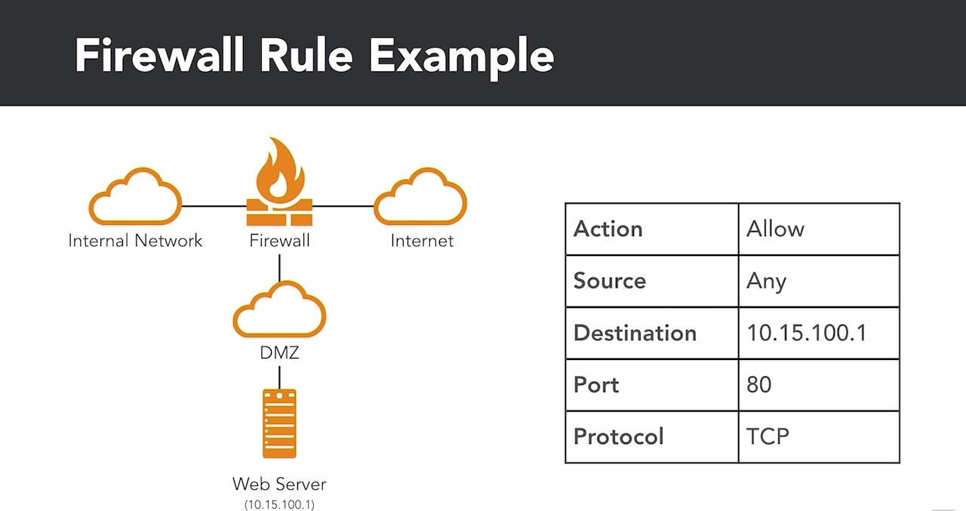

Slide 78
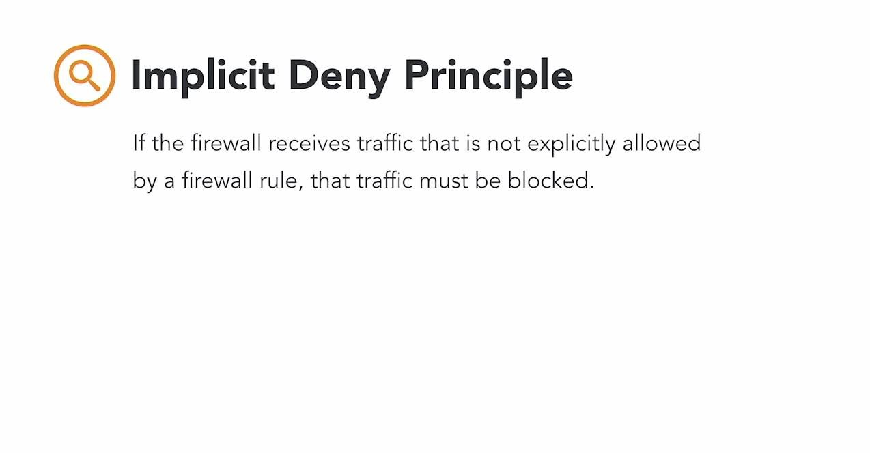

Slide 79
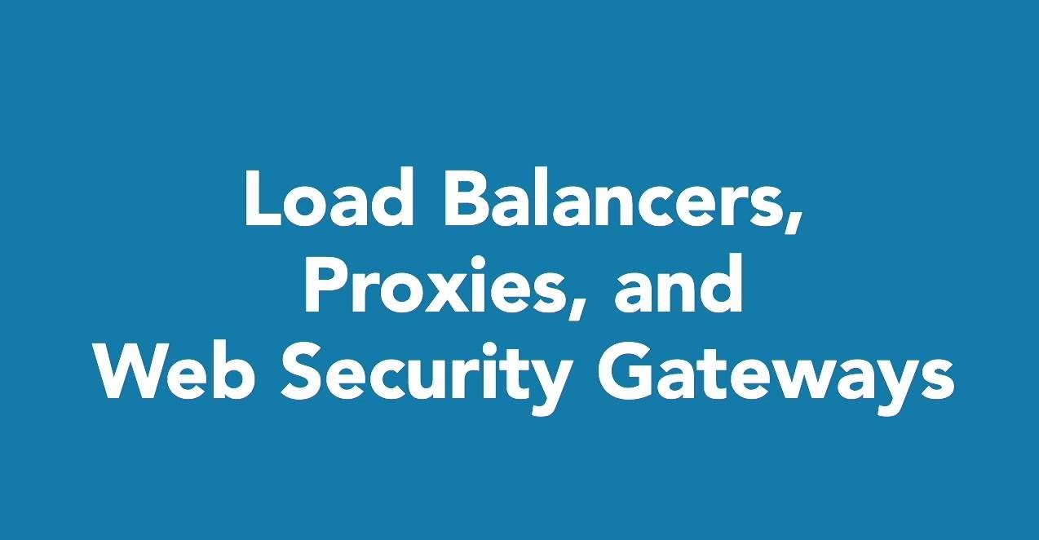

Slide 80
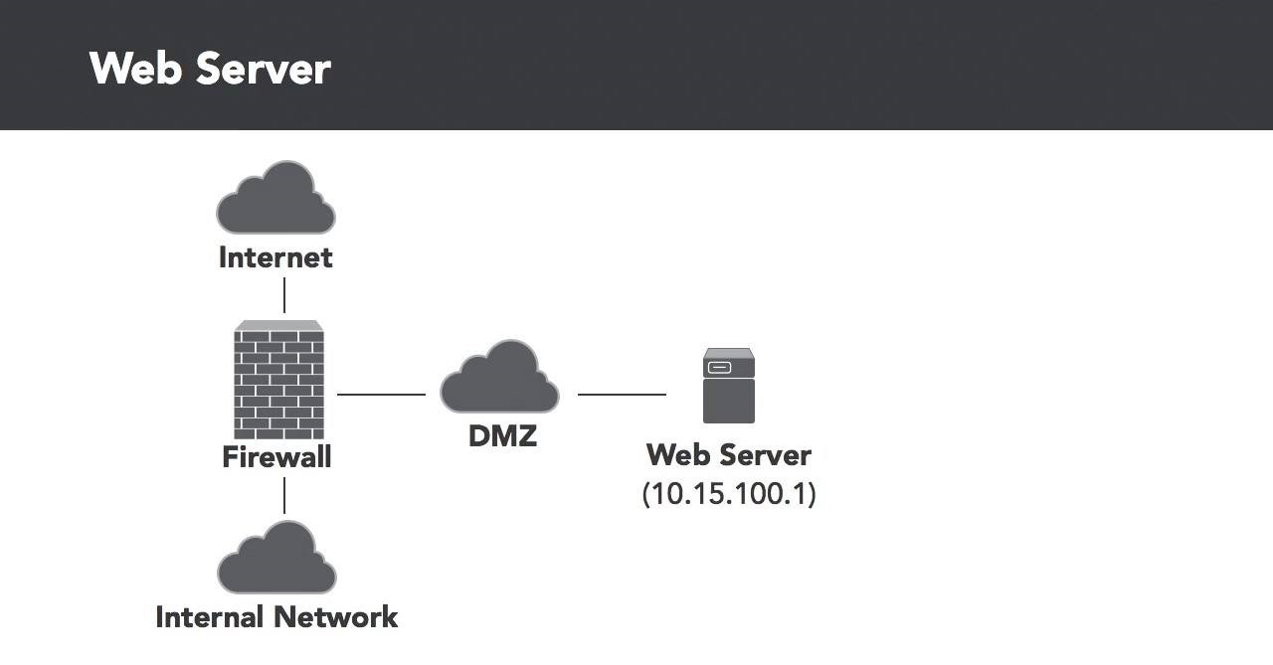

Slide 81


Slide 82


Slide 83


Slide 84


Slide 85


Slide 86


Slide 87


Slide 88


Slide 89


Slide 90


Slide 91


Slide 92


Slide 93


Slide 94


Slide 95


Slide 96


Slide 97


Slide 98


Slide 99


Slide 100


Slide 101


Slide 102


Slide 103


Slide 104


Slide 105


Slide 106


Slide 107


Slide 108


Slide 109

in the 1980s and 1990s, the enterprise IT landscape shifted dramatically We moved away from the world of monolithic mainframes to a new environment of client server computing.
This shift brought tremendous benefits. First, it put computing power right on the desktop, allowing users to perform many actions directly on their own machines without requiring mainframe access.

Slide 110

The client server model has served us well but it's also resulted in wasted resources.
Data center managers realized that most of the time many of their servers were sitting idle, waiting for a future burst in activity. That's not very efficient.

Slide 111

Virtualization technology is designed to enforce isolation strictly, and the providers of virtualization technology take seriously any vulnerabilities that might allow VM escape.
Security professionals working in virtualized environments should pay particular attention to any security updates that affect their virtualization platforms, and they should apply patches promptly.

Slide 112


Slide 113


